Slide 1
Linear Algebra
Lecture 2

Slide 2
Introduction
to Matrices

Slide 3
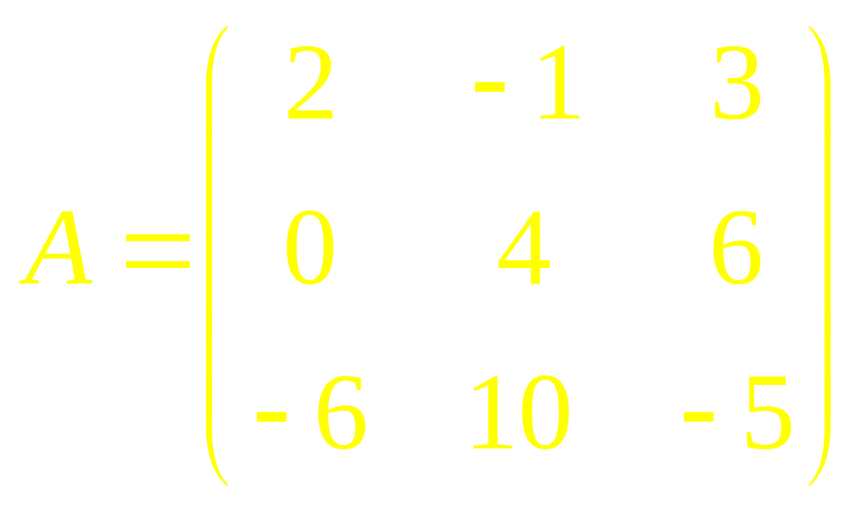
Matrix

Slide 4
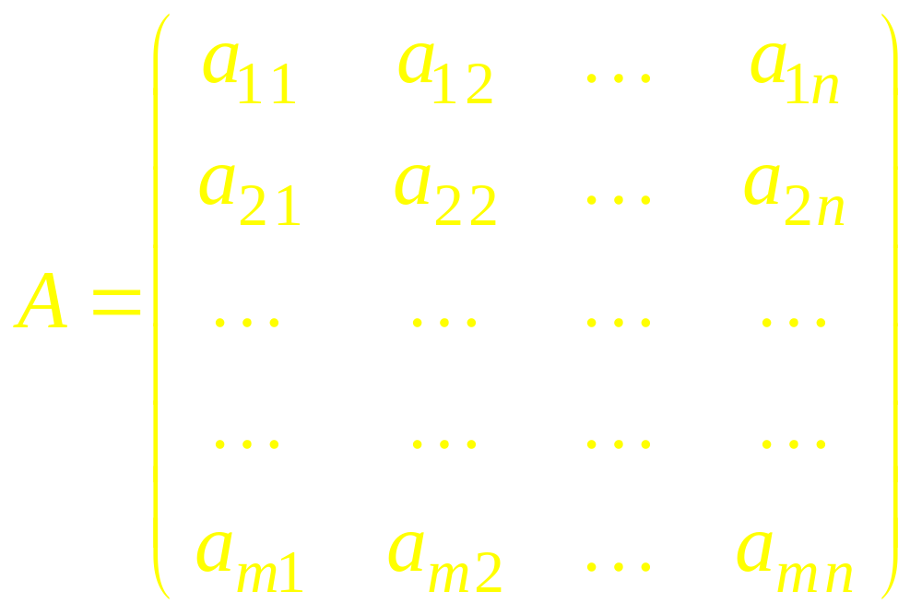
Matrix

Slide 5
Definitions
Square Matrix
Equality of Matrices
Column Matrix
Row Matrix (Vector)
Multiple of a Matrix

Slide 6
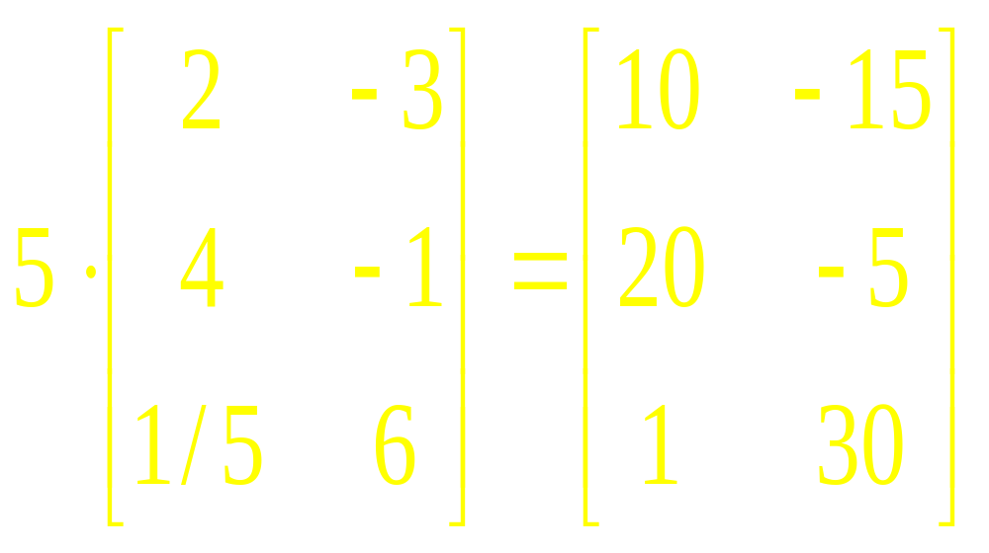
Example 1

Slide 7
Algebra
Addition of Matrices
Subtraction of Matrices
Multiplication of Matrices

Slide 8
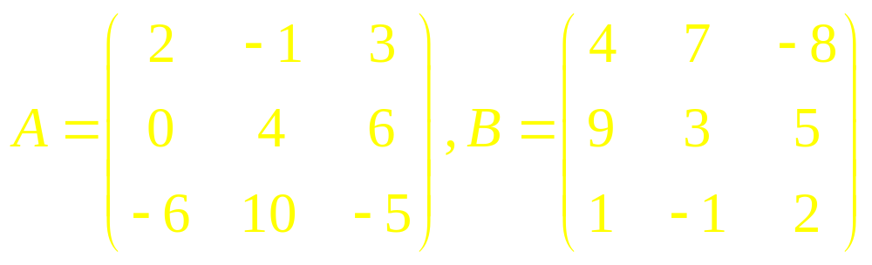
Example 2

Slide 9
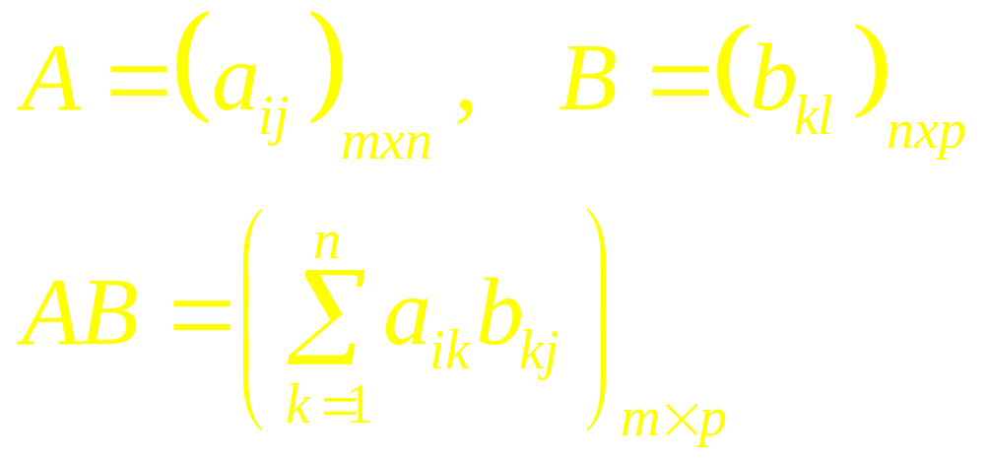
Multiplication

Slide 10
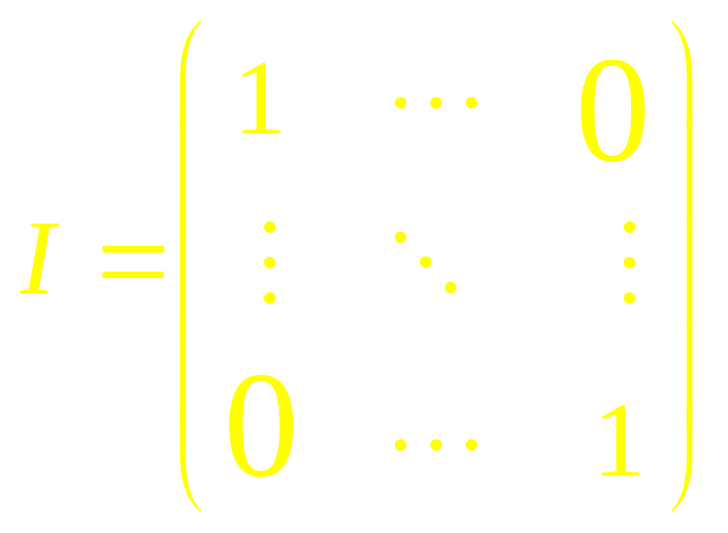
Multiplicative Identity

Slide 11
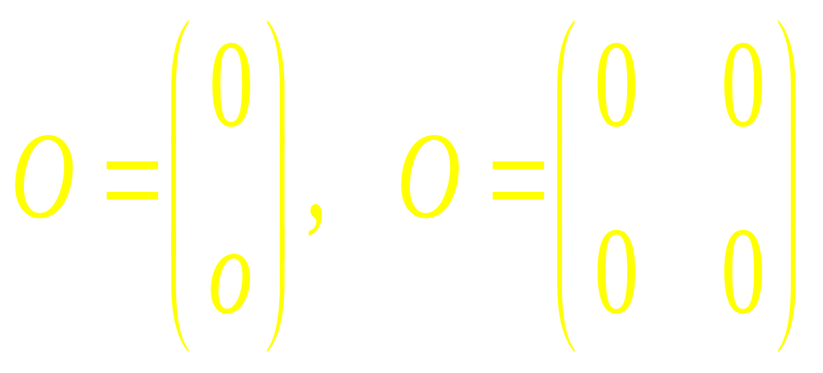
Zero Matrix

Slide 12
Commutative Law
A+B = B+A
AB=BA ? (NO)

Slide 13
Associative Law
A+(B+C) = (A+B)+C
A(BC)=(AB)C

Slide 14
Distributive Law
A(B+C) = AB + AC
(A+B)C = AC + BC

Slide 15

Determinant of a Matrix

Slide 16
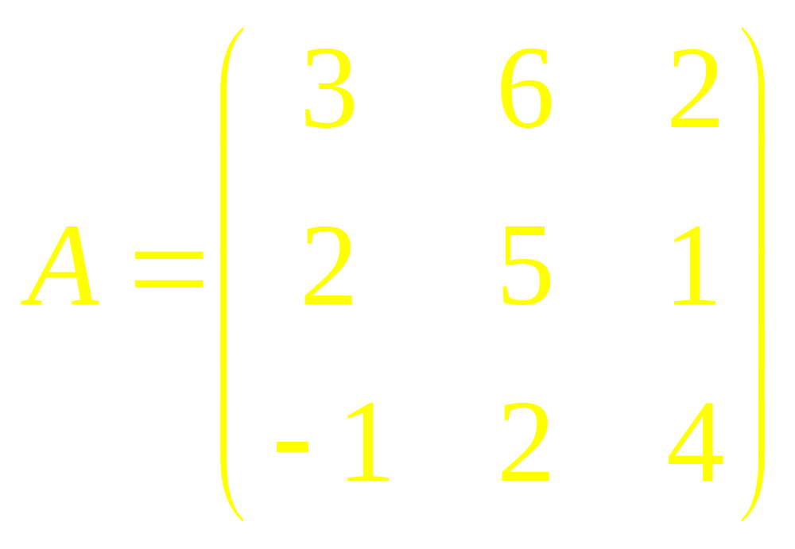
Example

Slide 17
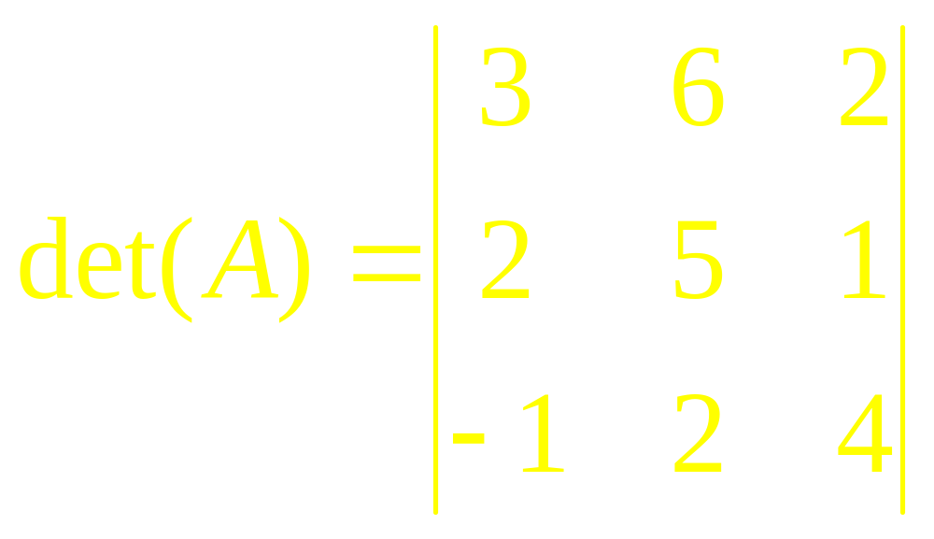

Slide 18
Definitions
Transpose of a Matrix
Symmetric Matrix
Singular Matrix
Non-Singular Matrix

Slide 19

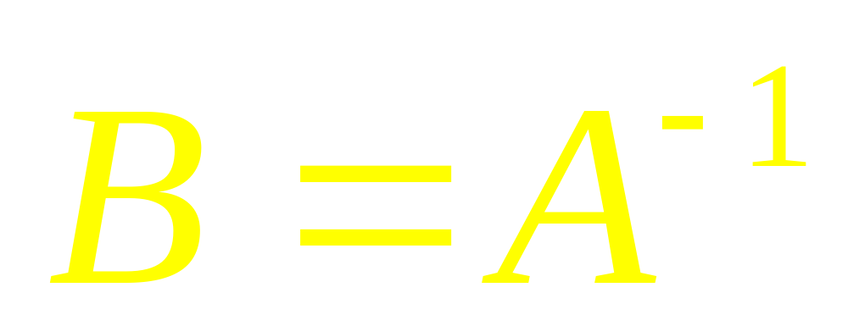
Multiplicative Inverse

Slide 20
Matrix Calculus
Derivative of a Matrix of Functions
Integral of a Matrix of Functions

Slide 21
Linear Algebra
Lecture 2

